Slide 1

Sales Performance Analysis Using Python, SQL & Power BI
Subtitle : Data Storytelling & Statistical Validation
Project Information:
Prepared By:
Cherukuri Bhavya Sree
Internship:
ApexPlanet Software Pvt. Ltd
Role:
Data Analystics Intern
Tools Used:
Python, SQL, Power BI, Excel
Date:
July 2026

Slide 2

Business Problem & Objectives
Business Problem
The company wants to analyze its sales data to understand customer purchasing behavior, product performance, and sales trends. The goal is to identify the key factors affecting total sales and use data-driven insights to improve business performance and decision-making.
Project Objectives
Analyze overall sales performance.
Identify top-selling products and categories.
Understand customer purchasing behavior based on age, gender, and city.
Analyze sales trends over time.
Compare sales performance across different cities.
Generate business insights using Python, SQL, and Power BI.
Provide recommendations to improve sales performance.
Why This Analysis Is Important
Improve overall sales and revenue.
Understand customer buying patterns.
Identify the best-performing products and categories.
Support better inventory planning.
Help management make data-driven business decisions.
Improve marketing strategies based on customer insights.

Slide 3
Dataset Overview
Attribute | Value
Dataset Name | ApexPlanet_Data Analytics_Dataset
Number of Records(Rows) | 1001
Number of Features(Columns) | 12
Data Type | Sales Transaction Data
Missing Values | No Missing Values
Duplicate Records | Checked and removed during preprocessing
Target Variable | Total_Sales
Dataset Features
Order_ID
Order_Date
Customer_ID
Customer_Name
Age
Gender
City
Product
Category
Quantity
Unit_Price
Total_Sales

Slide 4
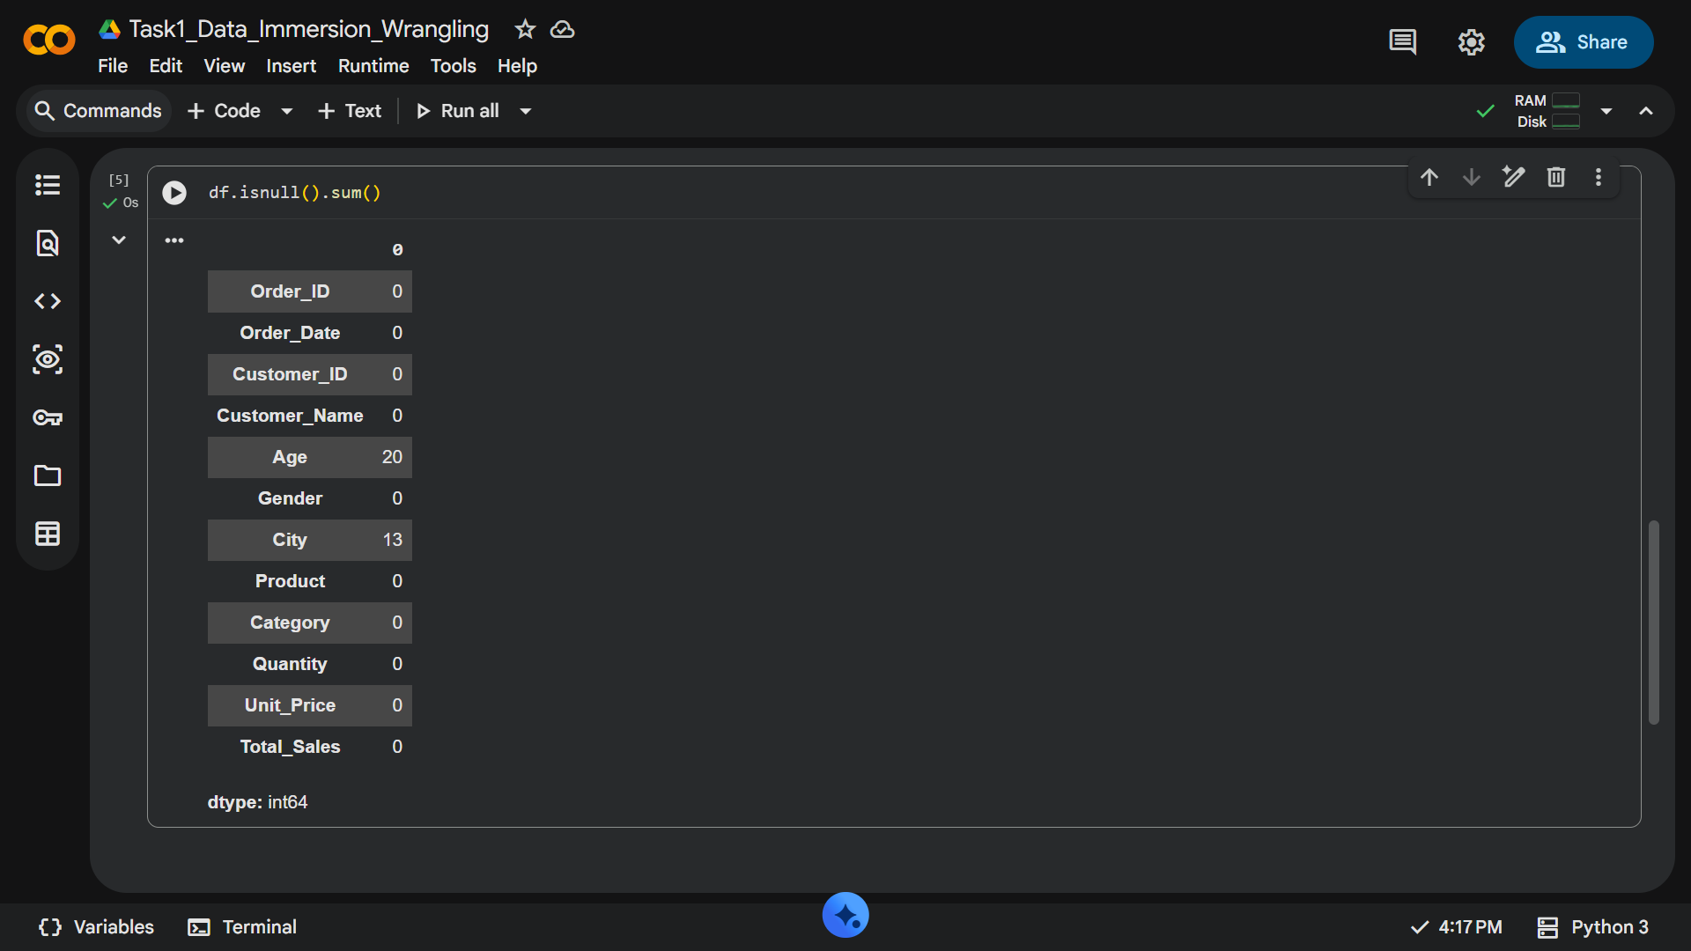
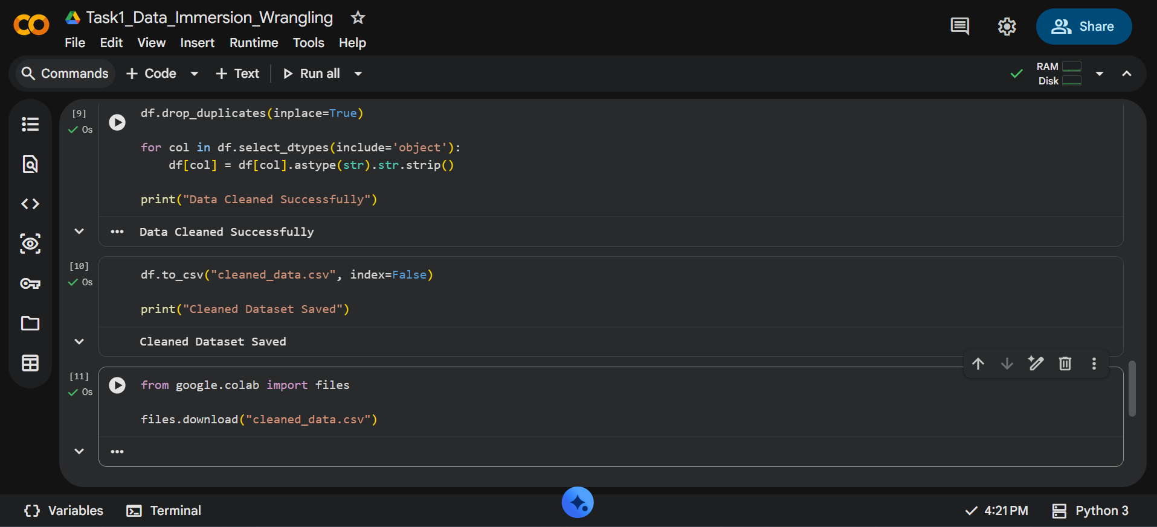
Data Cleaning & Preprocessing Data Cleaning Process ✔ Checked missing values ✔ Standardized column names ✔ Removed unnecessary spaces ✔ Verified duplicate records ✔ Converted data types ✔ Prepared data for analysis
Before Cleaned Data
After Cleaned Data

Slide 5
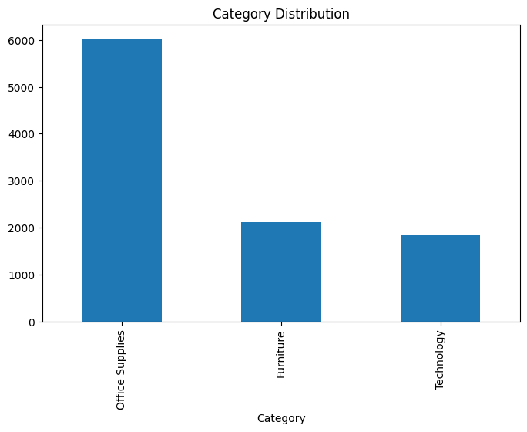
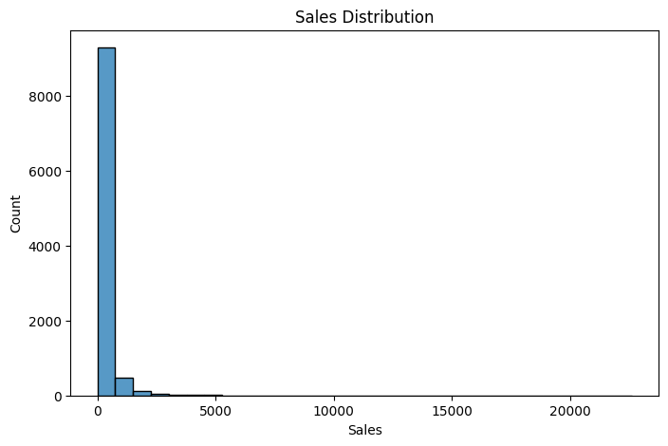
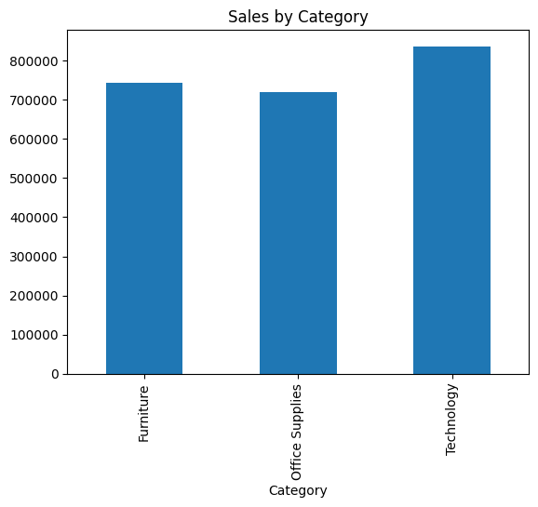
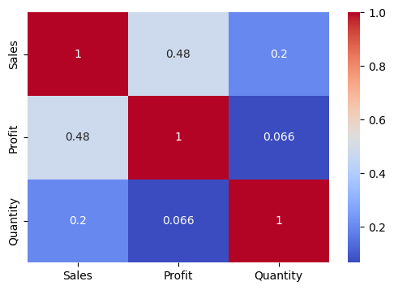
Exploratory Data Analysis(EDA)
Sales Distribution(Histogram)
Most transactions have lower sales values, while a few high-value transactions contribute significantly to total sales.
Category-wise Sales(Bar Chart)
Some product categories generate higher sales than others.
Correlations Heatmap
Positive correlations exist between some numerical variables, helping identify key business relationships.
Top Products
A small number of products contribute the highest revenue.

Slide 6
SQL Analysis Objective: SQL was used to query the sales database and answer key business questions efficiently. The analysis helped identify sales performance, product trends, and customer purchasing patterns
Business Questions Answered Using SQL
✔ What is the total sales generated by the business?
✔ What is the average sales per transaction?
✔ Which products generate the highest sales?
✔ Which product category contributes the highest revenue?
SQL Queries Used
1.Total Sales
Query: SELECT SUM(Total_Sales) AS Total_Sales FROM Sales;
2. Average Sales
Query: SELECT AVG(Total_Sales) AS Average_Sales FROM Sales;

Slide 7
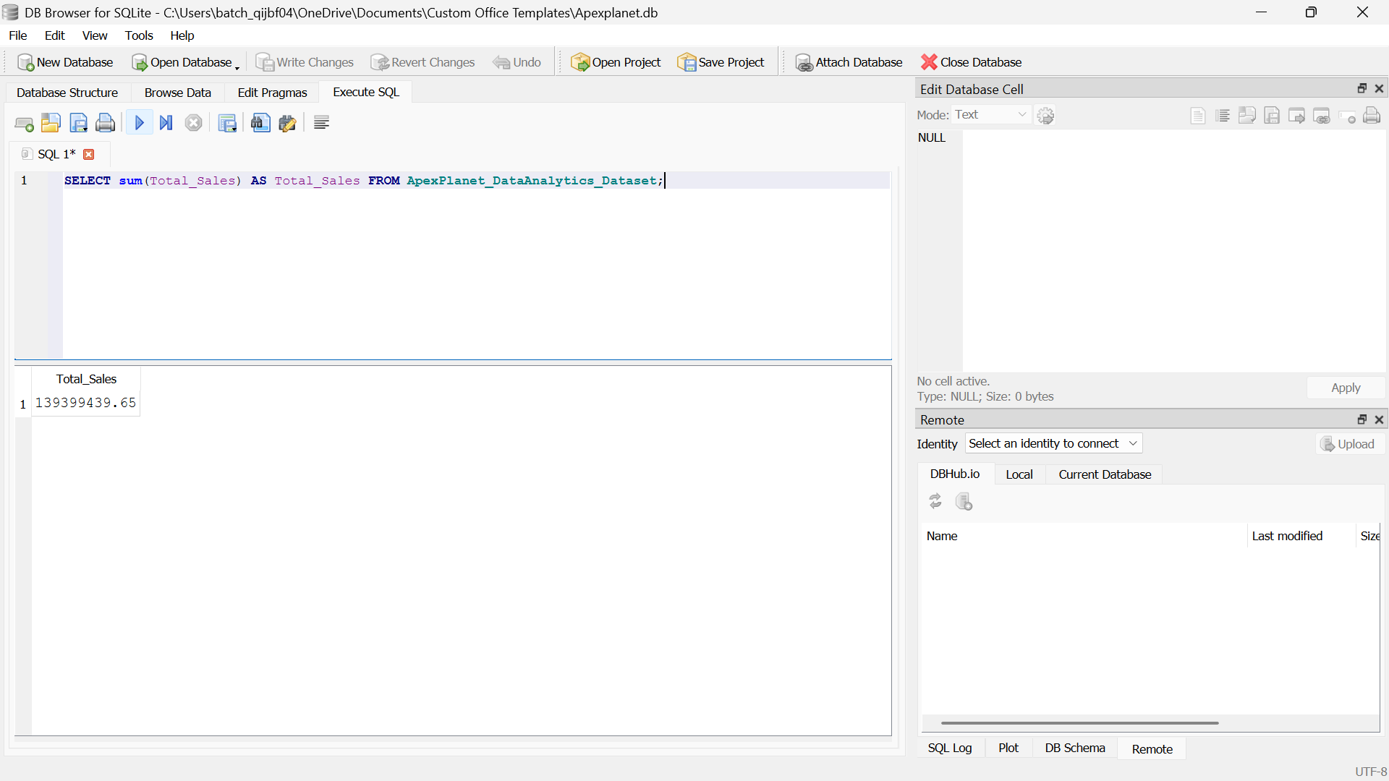
SQL Queries Used 3.Top Selling Products Query: SELECT Product, SUM(Total_Sales) AS Total_Sales FROM Sales GROUP BY Product ORDER BY Total_Sales DESC; 4.Category-wise Sales Query: SELECT Category, SUM(Total_Sales) AS Total_Sales FROM Sales GROUP BY Category ORDER BY Total_Sales DESC; Key Insights • SQL enabled quick business analysis. • Identified top-performing products. • Summarized sales information efficiently.
1.Total Sales Query: SELECT SUM(Total_Sales) AS Total_Sales FROM Sales;

Slide 8
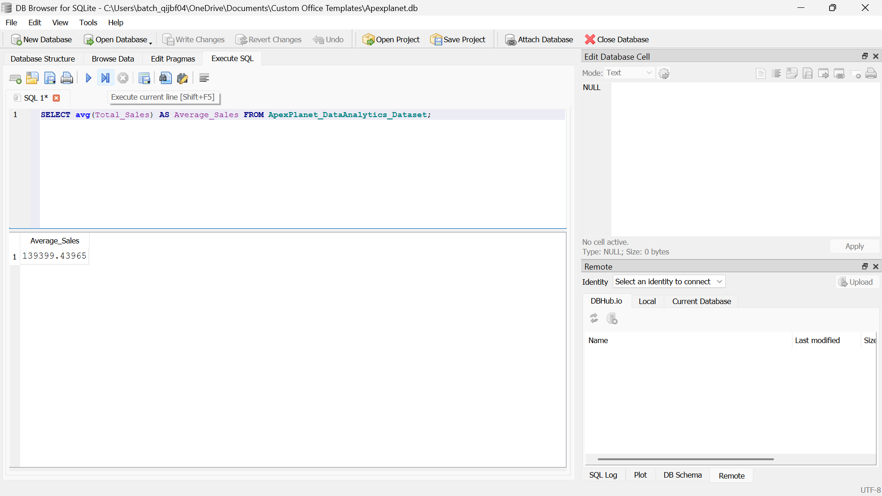
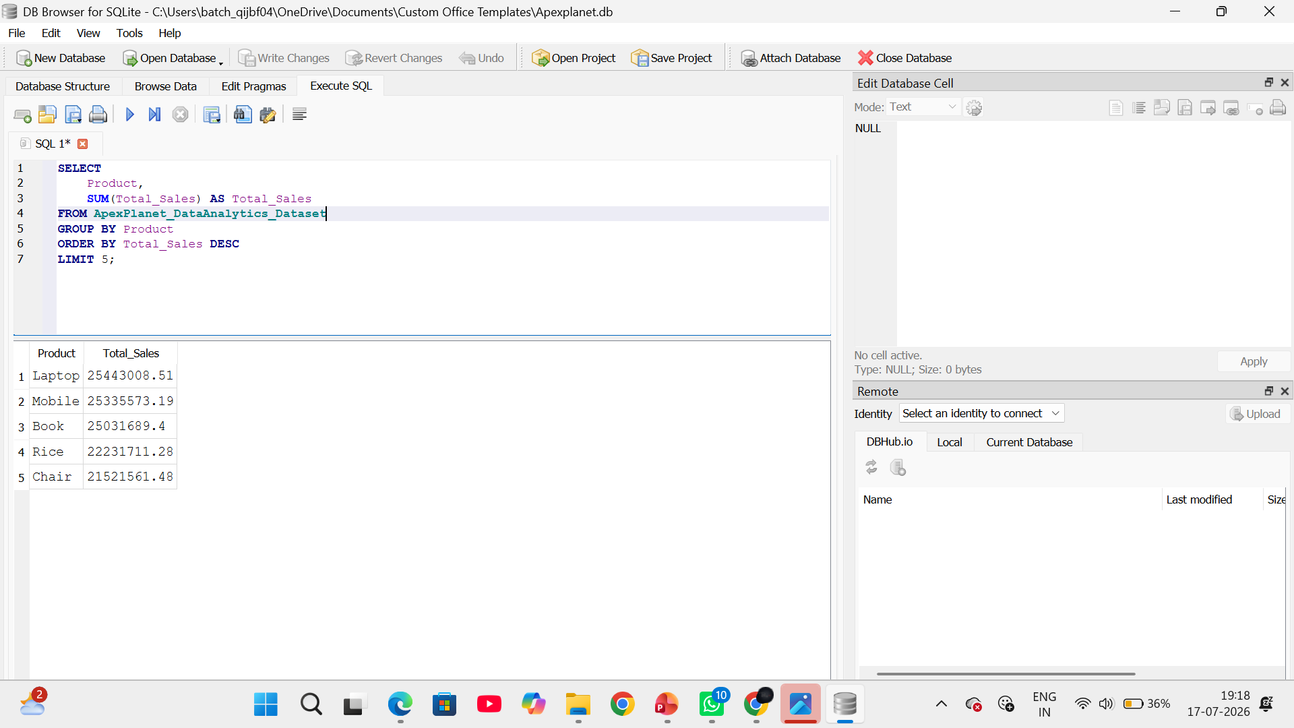
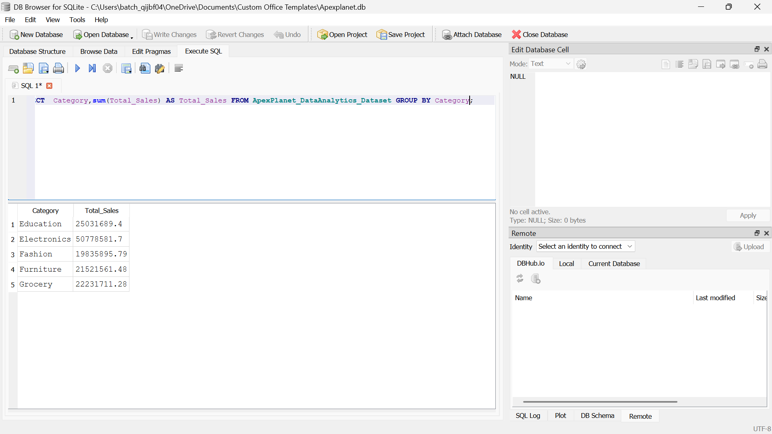
2. Average Sales Query: SELECT AVG(Total_Sales) AS Average_Sales FROM Sales;
3.Top Selling Products Query: SELECT Product, SUM(Total_Sales) AS Total_Sales FROM Sales GROUP BY Product ORDER BY Total_Sales
4.Category-wise Sales Query: SELECT Category, SUM(Total_Sales) AS Total_Sales FROM Sales GROUP BY Category ORDER BY Total_Sales DESC;

Slide 9
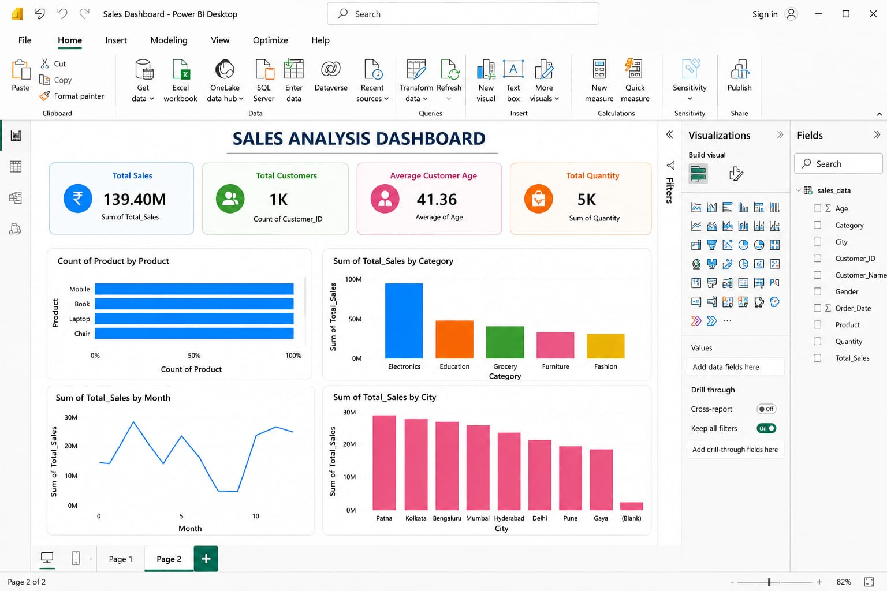
Power BI Dashboard
KPIs
✔ Total Sales
✔ Total Orders
✔ Average Sales
✔ Total Quantity Sold
Interactive Filters
✔ Category
✔ Product
✔ City
✔ Gender
Visualizations
✔ Bar Chart
✔ Histogram
✔ Heatmap
✔ KPI Cards
Key Benefit
• Interactive dashboard for business decision-making.

Slide 10

Business Insights
Key Business Insights
Electronics generated the highest total sales, making it the best-performing product category.
Education ranked second in total sales, followed by Grocery, Furniture, and Fashion.
Laptop is the top-selling product, followed closely by Mobile, indicating strong demand for electronic products.
Patna recorded the highest total sales among all cities, followed by Kolkata, Bengaluru, Mumbai, and Hyderabad.
The customer base is well balanced, with 511 male customers and 489 female customers.
Sales transactions cover multiple categories and cities, helping identify regional and product-level business opportunities.
The analysis highlights that electronic products contribute significantly to overall business revenue.

Slide 11

Statistical Validation
Hypothesis
Null Hypothesis (H₀): There is no significant relationship between Quantity Sold and Total Sales.
Alternative Hypothesis (H₁): There is a significant relationship between Quantity Sold and Total Sales.
Statistical Test Used
Pearson Correlation Test
Results
Correlation Coefficient (r): 0.647
p-value: 1.71 × 10⁻¹¹⁹ (approximately 0.000)
Decision
Since p-value < 0.05, Reject the Null Hypothesis (H₀).
Conclusion
There is a statistically significant positive relationship between Quantity Sold and Total Sales. This means that, in general, as the quantity of products sold increases, the total sales value also increases.

Slide 12
Business Recommendations
Recommendations
✔ Maintain sufficient inventory for Electronics products, especially Laptops and Mobiles, to meet customer demand and avoid stock shortages.
✔ Increase marketing efforts in high-performing cities such as Patna, while creating targeted campaigns to improve sales in lower-performing cities.
✔ Develop promotional offers for lower-performing product categories to increase customer interest and boost sales.
✔ Analyze customer purchasing behavior regularly to identify buying trends and personalize marketing strategies.
✔ Monitor sales performance using the Power BI dashboard to support timely, data-driven business decisions.
✔ Use sales trends to improve inventory planning, ensuring that high-demand products are always available.

Slide 13
Conclusion
Successfully cleaned and preprocessed the ApexPlanet_DataAnalytics_Dataset-1 to ensure data quality and consistency.
Performed Exploratory Data Analysis (EDA) using Python to identify sales patterns, customer behavior, and product performance.
Used SQL to answer key business questions, including total sales, average sales, top-selling products, and category-wise sales.
Developed an interactive Power BI dashboard to visualize KPIs, sales trends, and business performance.
Generated valuable business insights, including the highest-performing product categories, top-selling products, and city-wise sales performance.
Validated the findings using Pearson Correlation Analysis, confirming a statistically significant positive relationship between Quantity Sold and Total Sales.
Proposed practical business recommendations to improve sales performance, inventory management, and decision-making.

Slide 14
Thank you

